Slide 1
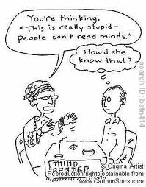
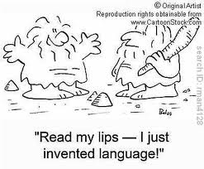
Reading Strategies
Follow these suggestions to help you read better!

Slide 2
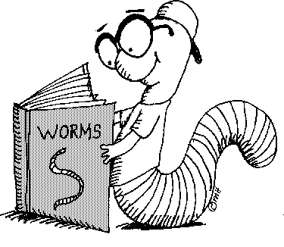
Reading Strategies
Predicting - Make opinions of what you think the text is about
- What do you already know about the topic?
Self-questioning - Ask questions while reading. Such as, "What is the main idea?" and "Are there examples to help me understand what I just read?"
Paraphrasing - Put ideas of a passage or section into your own words, or by summarizing the main points.

Slide 3
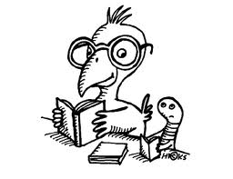
Reading Strategies
Visual Representation – Imagine and picture ideas with what you read and make connections.
Guessing Word Meanings - Guess the meanings of words by making use of contextual clues.
Changing Reading Speed
- Modify your reading speed for good comprehension.
- Determine when to read faster (for example, a newspaper) or slower (for example, a book).

